Slide 1
Angular HTTP service

Slide 2
The Angular http service makes a request to the server, and returns a response.
There are several HTTP methods:
.get()
.post()
.delete()
.head()
.options()
.patch()
.put()

Slide 3
Setting up angular/http

Slide 4
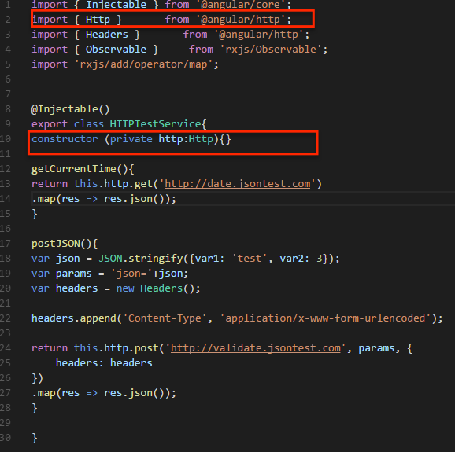
In order to use the new Http module in our components we have to import Http After that, we can just inject it via Dependency Injection in the constructor.

Slide 5
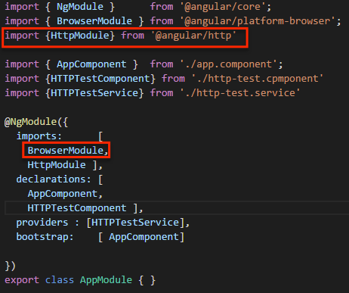
Besides the changes to our components using Http, we also need to include HttpModule during bootstrap.
For Angular 2, Http is no longer included in the core but as a separate file.

Slide 6
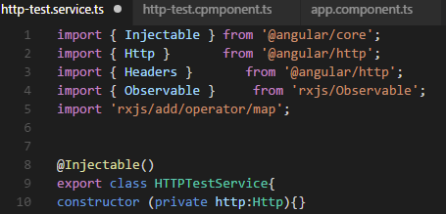
Creating a simple Http Service
Lets add the @Injectable decorator (line 8). This indicates the Dependency Injector that the class has dependencies that should be injected into the constructor when creating an instance of the class.
Lets define a simple service using a class (line 9) and also preceded it with export to make it accessible to other components.
The syntax to inject Http into the constructor’s http argument:
import {Http} from ‘@angular/http’; (line 2)
constructor(private http:Http){ ... } (line 10)

Slide 7

Http GET
On the constructor we are setting a public property this.http and callinghttp.get.
http.get returns an Observable emitting Responseobjects.
We used map to parse the result into a JSON object. This code is using an arrow function (in ES6) or fat arrow (aka lambda syntax in TypeScript).

Slide 8
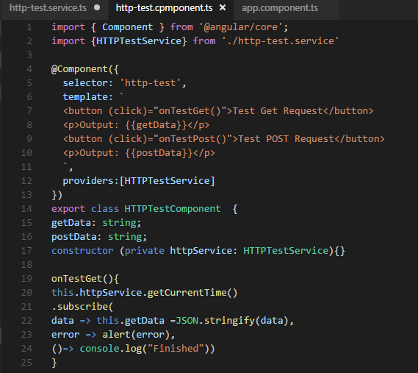
We imported HTTPTestService (line 2). Following, in the constructor, we injected the service using the same syntax we saw before (line 17).
During App instantiation, httpService.getCurrentTime() will return an Observable. We want to display a Current Time so we can use subscribe to set our local data variable when the data is emitted. In this case, we just set the result into this.postData

Slide 9
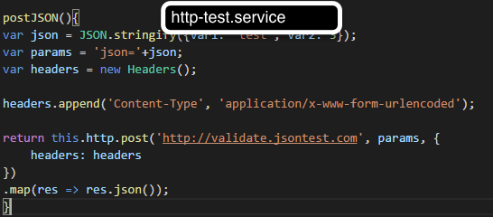
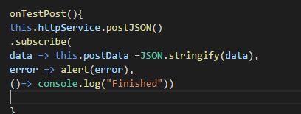
Http POST
We need to provide a url and a body, both strings and then optionally an options object. In our example we are passing the modified headers property. http.post returns an Observable, we use map to extract the JSON object from the response and subscribe. This will setup our stream as soon as it emits the result. Finally We call this.postData with the corresponding data token.
http-test.component

Slide 10
Links:
https://www.youtube.com/watch?v=L7xPwhwbcHE
https://medium.com/google-developer-experts/angular-2-introduction-to-new-http-module-1278499db2a0#.8lswrlcem
https://angular.io/docs/ts/latest/tutorial/toh-pt6.html

